Slide 1
Electronic Devices
Mid Term Lecture - 02
Faculty Name: Dr. Mohammad Alif Arman
Email : dr.alifarman@aiub.edu
Room: DN0526
Reference book:
Electronic Devices and Circuit Theory (Chapter-1)
Robert L. Boylestad and L. Nashelsky , (11th Edition)

Slide 2
Objectives
Develop a clear understanding of the basic operation and characteristics of a diode in the no-bias, forward-bias, and reverse-bias regions.
Be able to calculate the dc, ac, and average ac resistance of a diode from the characteristics.
Understand the impact of an equivalent circuit whether it is ideal or practical.
Become familiar with the operation and characteristics of a Zener diode and light- emitting diode.

Slide 3
Semiconductor Diode: No Applied Bias (V=0 V)
Now that both n – and p -type materials are available, we can construct our first solid-state electronic device: The semiconductor diode, with applications too numerous to mention, is created by simply joining an n -type and a p -type material together.
In the absence of an applied bias across a semiconductor diode, the net flow of charge in one direction is zero.

Slide 4
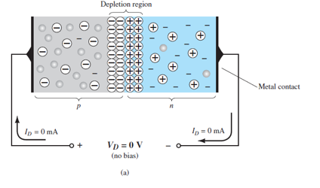
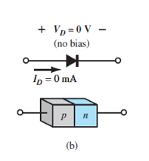
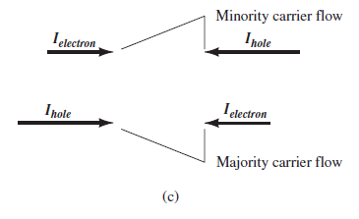

No Applied Bias (VD=0 V)

Slide 5
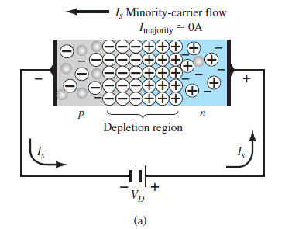
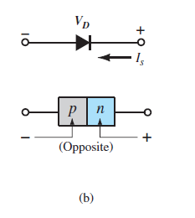

Reverse-Bias Condition (VD<0 V)
The current that exists under reverse-bias conditions is called the reverse saturation current and is represented by I_{s} .

Slide 6
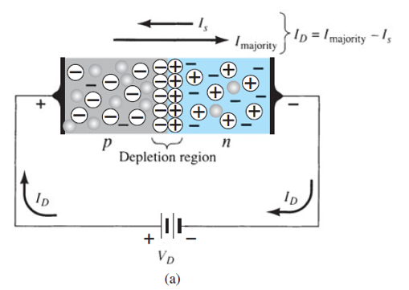
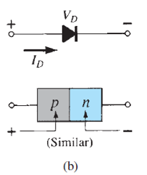

Forward-Bias Condition (VD>0 V)
A forward-bias or “on” condition is established by applying the positive potential to the p -type material and the negative potential to the n -type material as shown in Fig. 1.14 .

Slide 7

Forward-Bias Condition (VD>0 V) Contd.
It can be demonstrated through the use of solid-state physics that the general characteristics of a semiconductor diode can be defined by the following equation, referred to as Shockley’s equation, for the forward- and reverse-bias regions:
Where, I_{s} is the reverse saturation current
V_{D} is the applied forward-bias voltage across the diode
n is an ideality factor, which is a function of the operating conditions and physical construction; it has a range between 1 and 2 depending on a wide variety of factors (n = 1 will be assumed throughout this text unless otherwise noted).

Slide 8

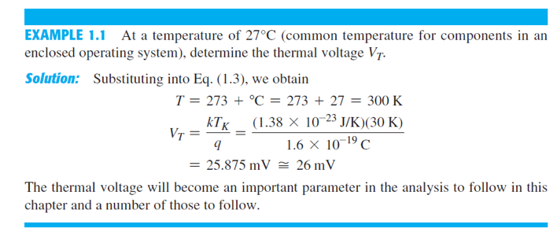
Forward-Bias Condition (VD>0 V) Contd.
The voltage V_{T} in Eq. (1.1) is called the thermal voltage and is determined by:
where k is Boltzmann’s constant = 1.38 * 10⁻²³ J/K
T_{K} is the absolute temperature in kelvins = 273 + the temperature in °C
q is the magnitude of electronic charge = 1.6 * 10⁻¹⁹ C

Slide 9
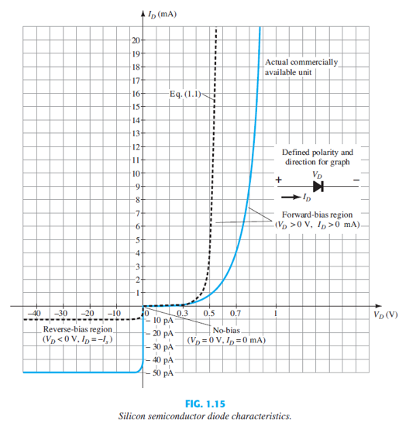
Semiconductor Diode Characteristics

Slide 10
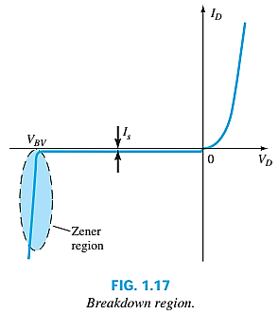
Breakdown Region
The maximum reverse-bias potential that can be applied before entering the breakdown region is called the peak inverse voltage (referred to simply as the PIV rating) or the peak reverse voltage (denoted the PRV rating).
If an application requires a PIV rating greater than that of a single unit, a number of diodes of the same characteristics can be connected in series. Diodes are also connected in parallel to increase the current-carrying capacity.
In general, the breakdown voltage of GaAs diodes is about 10% higher those for silicon diodes but after 200% higher than levels for Ge diodes.

Slide 11
Breakdown Region Contd.
As the voltage across the diode increases in the reverse-bias region, the velocity of the minority carriers responsible for the reverse saturation current Is?
Eventually, their velocity and associated kinetic energy (W_{K} = 1/2 mv²) will be sufficient to release additional carriers through collisions with otherwise stable atomic structures.
An ionization process will result whereby valence electrons absorb sufficient energy to leave the parent atom.
These additional carriers can then aid the ionization process to the point where a high avalanche current is established and the avalanche breakdown region determined.
will also increase.

Slide 12
Breakdown Region Contd.
The avalanche region (V_{BV}) can be brought closer to the vertical axis by increasing the doping levels in the p- and n-type materials.
However, as V_{BV} decreases to very low levels, such as -5 V, another mechanism, called Zener breakdown, will contribute to the sharp change in the characteristic.
It occurs because there is a strong electric field in the region of the junction that can disrupt the bonding forces within the atom and “generate” carriers.
Although the Zener breakdown mechanism is a significant contributor only at lower levels of V_{BV}, this sharp change in the characteristic at any level is called the Zener region, and diodes employing this unique portion of the characteristic of a p–n junction are called Zener diodes.

Slide 13
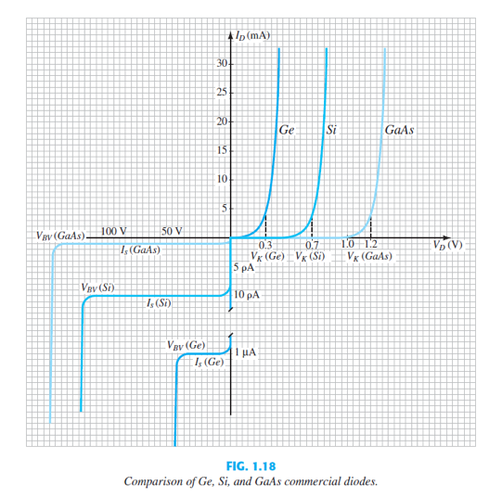
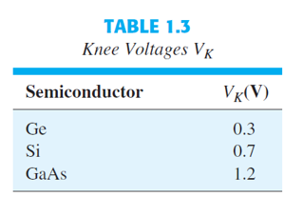
Ge, Si & GaAs
Knee voltage is the forward voltage at which the flow of the current through the PN junction of the diode increases rapidly.

Slide 14
Temperature Effects
In the forward-bias region the characteristics of a silicon diode shift to the left at a rate of 2.5 mV per centigrade degree increase in temperature.
In the reverse-bias region the reverse current of a silicon diode doubles for every 10°C rise in temperature.
The reverse breakdown voltage of a semiconductor diode will increase or decrease with temperature.
As temperature increases it adds energy to the diode:
It reduces the required forward bias voltage for forward bias conduction.
It increases the amount of reverse current in the reverse bias condition.
It increases maximum reverse bias avalanche voltage.
Germanium diodes are more sensitive to temperature variations than silicon or gallium arsenide diodes.

Slide 15
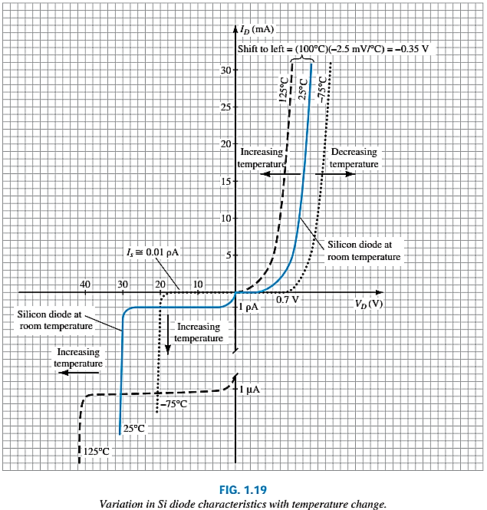
Temperature Effect Contd.
In the forward-bias region the characteristics of a silicon diode shift to the left at a rate of 2.5 mV per centigrade degree increase in temperature.
In the reverse-bias region the reverse current of a silicon diode doubles for every 10°C rise in temperature.
Finally, The reverse breakdown voltage of a semiconductor diode will increase or decrease with temperature.

Slide 16
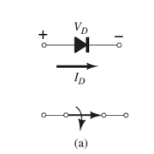
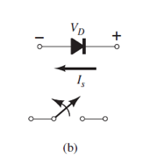

Ideal vs Practical
The semiconductor diode behaves in a manner similar to a mechanical switch in that it can control whether current will flow between its two terminals.
The semiconductor diode is different from a mechanical switch in the sense that when the switch is closed it will only permit current to flow in one direction.

Slide 17
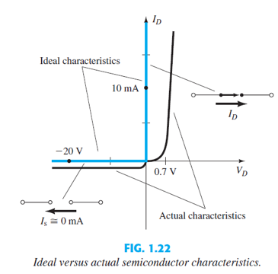
Ideal vs Practical Contd.
Ideally, if the semiconductor diode is to behave like a closed switch in the forward-bias region, the resistance of the diode should be 0 Ω.
In the reverse-bias region its resistance should be ∞ Ω to represent the open-circuit equivalent.

Slide 18
Resistance Levels
Semiconductors react differently to DC and AC currents.
There are three types of resistance:
DC (static) resistance
AC (dynamic) resistance
Average AC resistance

Slide 19
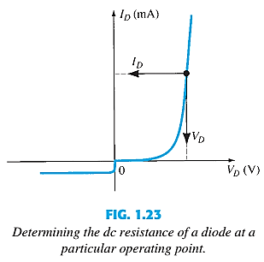

DC or Static Resistance
For a specific applied DC voltage V_{D,} the diode has a specific current I_{D}, and a specific resistance R_{D}.
In general, therefore, the higher the current through a diode, the lower is the dc resistance level.
I
R

Slide 20
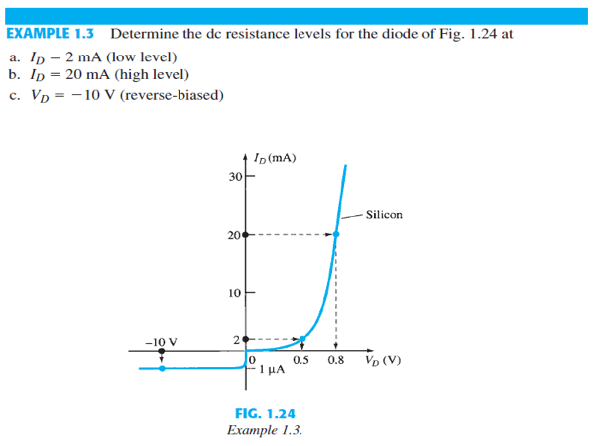
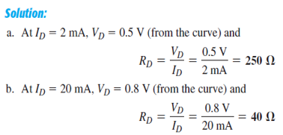
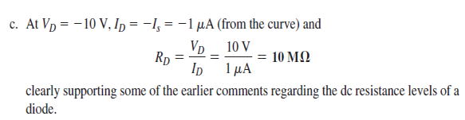

Slide 21
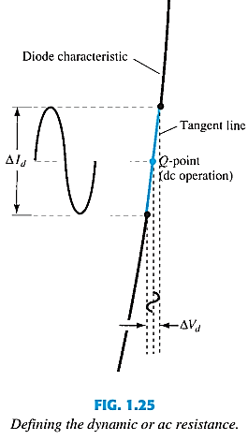
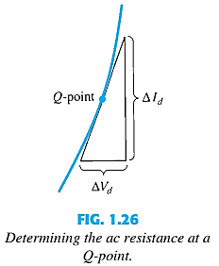
AC or Dynamic Resistance
The dc resistance of a diode is independent of the shape of the characteristic in the region surrounding the point of interest.
The designation Q-point is derived from the word quiescent, which means “still or unvarying.”
In general, therefore, the lower the Q-point of operation (smaller current or lower voltage), the higher is the ac resistance.
See Example 1.4.

Slide 22


AC or Dynamic Resistance Contd.
In the forward bias region:
The resistance depends on the amount of current (I_{D}) in the diode.
The voltage across the diode is fairly constant (26 mV for 25°C).
r_{B} ranges from a typical 0.1 Ω for high power devices to 2 Ω for low power, general purpose diodes. In some cases r_{B} can be ignored.
In the reverse bias region:
The resistance is effectively infinite. The diode acts like an open.

Slide 23
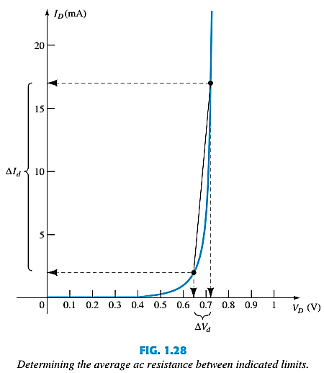

Average AC or Resistance
The average ac resistance is, by definition, the resistance determined by a straight line drawn between the two intersections established by the maximum and minimum values of input voltage.

Slide 24
Average AC or Resistance
Vmin = 0.65v Imin = 2mA
Vmax = 0.725v Imax = 17mA
Vd = 0.725 – 0.65 = 0.075V
Id = 17 – 2 = 15mA
Rav = 0.075/15 = 5ohm
Rd Vd = 0.65 > 5 ohm
Rd Vd = 0.725 < 5 ohm

Slide 25
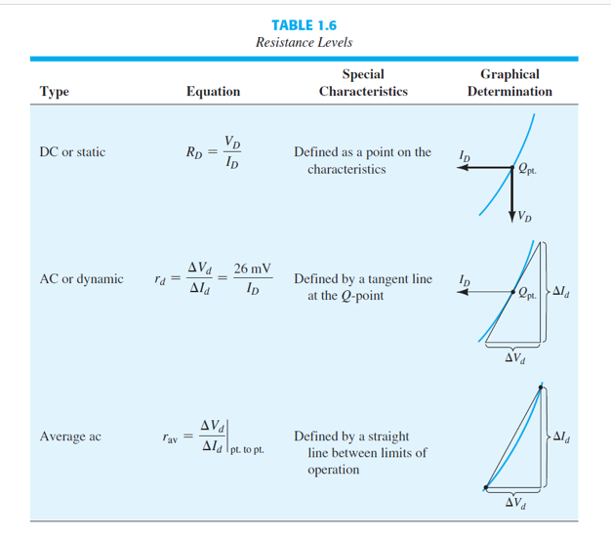
Summary table

Slide 26
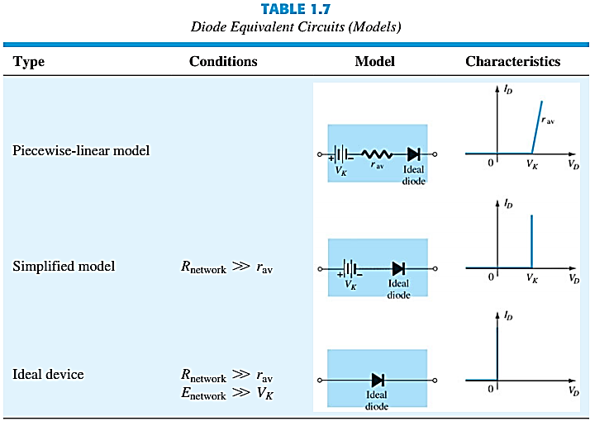
Diode Equivalent Circuits
An equivalent circuit is a combination of elements properly chosen to best represent the actual terminal characteristics of a device or system in a particular operating region.

Slide 27
Thank You

Slide 28
Outcome
Knowledge
Basic of PN Junction
Forward, reverse bias and zero bias voltage
Resistance
Principles of Semiconductor growth mechanism
Practical applications
Circuit
Working principle of Diode
Diodes can perform switching and digital logic operations.

